Slide 1
Submission to Complete the Exploratory Portion of Capstone Project
Tom Hunter

Slide 2
Starting point: The question and the data
Implied Volatility is a derived 1 standard deviation range in the pricing model of an option.
Since Implied volatility is a forward looking estimation of a standard deviation, is it correlated to actual realized returns in the market and if so what is the relationship?
Background questions and real world applications:
Data Sets Utilized:
Libraries Required
Is there a relationship that exists between realized and implied returns in the derivative markets?
If so, what does implied volatility say about future realized returns in the stock market and does it give context?
S&P 500 Index (1/1/2000 – 12/31/2015)
CBOE Volatility Index (1/1/2000 – 12/31/2015)
library(quantmod)
library(dplyr)
library(tidyr)
library(lattice)
library(ggplot2)
library(TTR)
library(gtools)
library(DataCombine)
library(gmodels)
library(pastecs)
library(psych)
Sources of Data:
All data was pulled from the Historical datasets found on Yahoo Finance. The source of this data can be found at:
http://finance.yahoo.com/

Slide 3
Data Background--
Details regarding data
S&P 500 Index (1/1/2000 – 12/31/2015)
Ticker Symbol: ^GSPC
Called from Historical Data on Yahoo Finance
Background of Data: The Standard & Poor's 500 is one of the three primary US Stock indexes. It is comprised of 500 US stocks based on their market capitalization and is one of the most commonly followed equity indices because of the diversity of it’s industry holdings.
CBOE Volatility Index (1/1/2000 – 12/31/2015)
Ticker Symbol: VIX
Called from Historical Data on Yahoo Finance
Background of Data: The Chicago Board of Options Exchange Volatility Index measures the implied volatility of the S&P500 index Options over a 30 day period as a percent of the underlying, this number is then annualized which is the index.
Sources:
https://en.wikipedia.org/wiki/S%26P_500_Index
https://en.wikipedia.org/wiki/VIX
Sources of Data:
All data was pulled from the Historical datasets found on Yahoo Finance. The source of this data can be found at:
http://finance.yahoo.com/

Slide 4
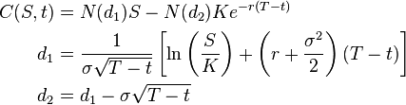
Background Information– How to calculate implied volatility.
How an option gets priced
Stock Price (S)
Stock Price- Represents price of stock at moment of measurement
Strike Price- An agreement on price between a buyer and seller regarding when a contract is valid.
Time to Maturity- Time until contract expires
Interest Rate- What is the interest rate for the overall stock market?
Dividends- Is the option going to pay dividends during the period of the contract.
Implied Volatility- Expected future standard deviation priced into option of the underlying stock. It represents all of the extra risk being priced into the derivatives market.
Strike Price (K)
Time to Maturity (T-t)
Option Price
Interest Rate (r)
Dividends
Black-Sholes Model
Implied Volatility (σ)
N represents the cumulative distribution function of a normal standard deviation.

Slide 5
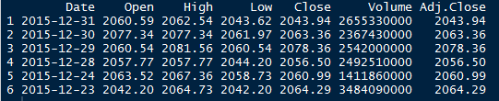
Transformation of Data
4025 Observations per dataset.
Date in incorrect classification for datasets to be merged
New time series variables could not be correctly computed in this order– required time periods to be sorted
Each data set need to be standardized for price movements, so changes could be compared regardless of price of underlying
Net New Time Series Variables:
In order to perform analysis, running Standard Deviations needed to be calculated, Implied volatility had to be merged and calculated for different time frames, closing prices had to be led, percentages
Resulted in:
Historic and Implied Standard Deviation analysis over 6 different time periods.

Slide 6
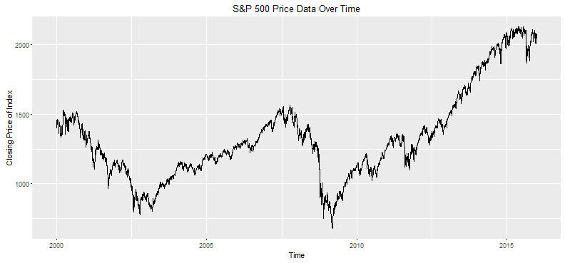
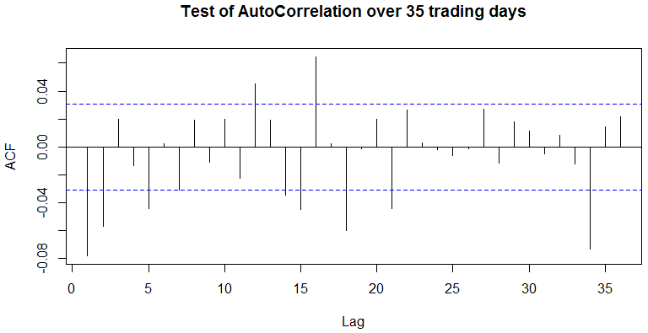
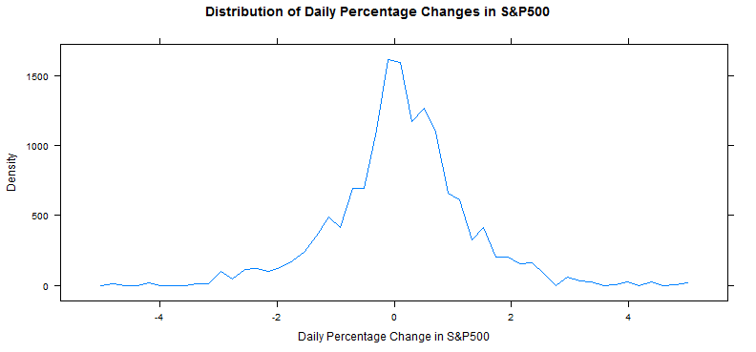
Exploration of Data: Standard & Poors 500
S&P 500 Index (1/1/2000 – 12/31/2015)
Figure on the right shows the relationship of the price over time. This is the cash value of the index since 1/1/2000 – 12/31/2015
On the bottom left, the of all of the % change in the stock market over time.
On the right tests the autocorrelation of market data. This chart shows a correlation range between .04 and -.08. This indicates a weak relationship in the data and therefore would not need to be scaled.
Graphs shows the S&P 500 over time
Graphs shows the distribution of percentage change in the S&P 500.
Graphs shows lack of auto-correlation in the data

Slide 7
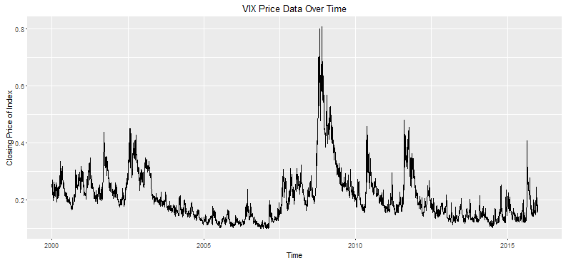
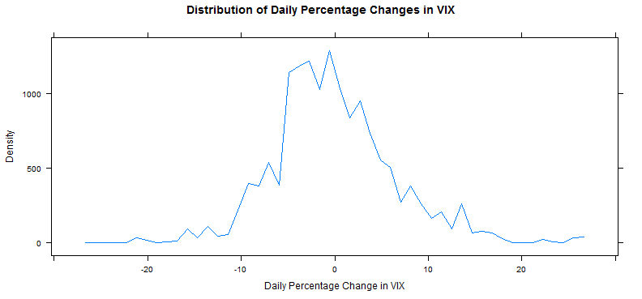
Exploration of Data: CBOE VIX Index
VIX Index (1/1/2000 – 12/31/2015)
Figure on the left shows the relationship of the price over time. This is the cash value of the index since 1/1/2000 – 12/31/2015
On the bottom left, the of all of the % change in the VIX over time.
On the bottom shows the summary statistics of this dataset and the VIX.
Note: The large peaks in the VIX correspond with uncertainly and selling behavior in the S&P 500- what does that mean? As the market sells off Option Prices are being adjusted up
Graphs shows the VIX index over time
Graphs shows the distribution of percentage change in the VIX

Slide 8
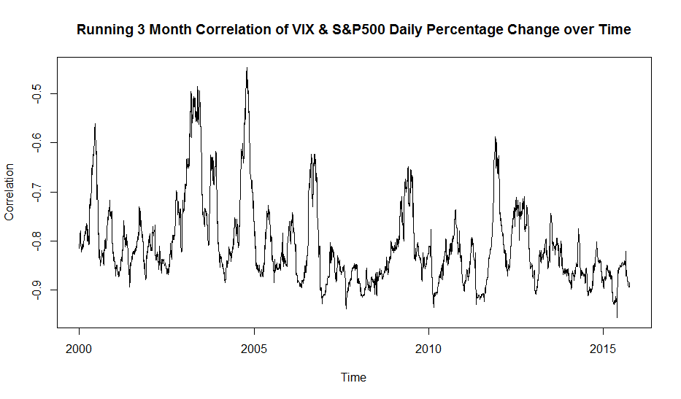
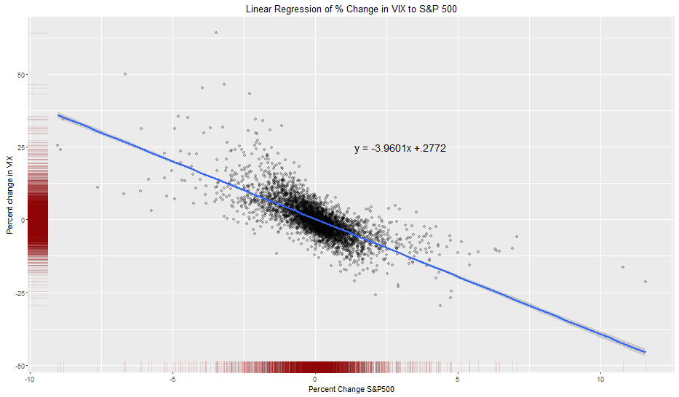
Exploration of Data: Relationship between S&P 500 and VIX Index
In the graph on the left, there is a -.74 correlation between the change in S&P 500 percent and the VIX percent. This graph shows a running 3 month correlation of between the VIX and S&P 500. Traders frequently try to arbitrage statistical discrepancies in these relationships.
In the graph on the right, I created a scatterplot of the daily change in the S&P 500 and the VIX Index then placed a linear regression model on these two variables. The variables were statistical significant with an adjusted R Squared of .55.

Slide 9
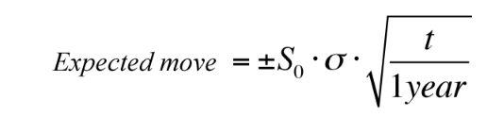
Exploring the Data: Lagging Period Returns
Period | Average trading days
Year | 251.5
Month | 21.9
I calculated the implied 1 STD range for each of the time periods and then I calculated the actual return during this period and compared this expected range to the absolute actual return.
Periods in Dataset | Average trading days
2 day | 2
1 Month | 21
3 Month | 63
6 Month | 126
9 Month | 189
12 Month | 252
Implied Volatility/ VIX

Slide 10
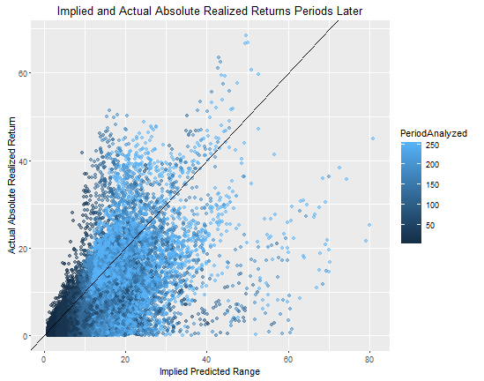
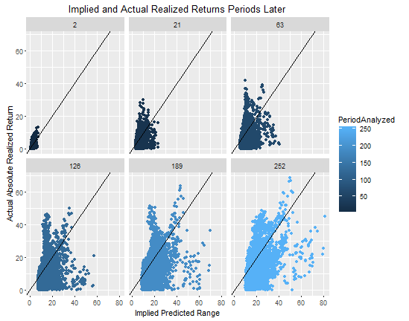
Exploring the Data: Lagging Period Returns
How Realized Returns compared against their implied predictions. Note Implied Tends to overestimate actual returns.
How Realized Returns compared against their implied predictions for each time period. Note Implied Tends to overestimate actual returns.

Slide 11
Final Analysis:
In final analysis, we noted that a t-test for each period resulted in statistically significant differences in the mean of the data being predicted.
The null hypothesis would expect that 66% (1 STD move) of observations would be within the threshold expected by Implied Volatility for each period, instead, we see that 72% - 84% of observations are within this threshold.
Status | 2 Days | 1 Month | 3 Month | 6 Month | 9 Month | 12 Month
Realized > Implied | 801 | 610 | 621 | 674 | 935 | 1061
Realized < Implied | 3222 | 3394 | 3341 | 3225 | 2901 | 2712
% Realized | 80.1% | 84.8% | 84.3% | 82.7% | 75.6% | 71.9%

Slide 12
Real World Takeaways:
Does implied volatility share a relationship with the current or future movements in the stock market?
Yes, while it’s important not to draw conclusions about causation and correlation, changes in the stock market today does impact the expected future movement in the stock market. While we cannot predict a future price, we can contextualize the range of movement.
Can we use implied volatility to contextualize real world movements so we can understand a range of risk and reward probabilities in portfolios instead of just being told to invest?
With the context that implied volatility tends to overstate actual returns, this could be used as a rough estimate for the range of future expected returns.
What else does this data suggest that can be inferred?
High Frequency Traders hedge their positions in the options markets to offset large directional positions. This research might suggest why they outperform hedge funds and traditional market returns- because there is an imbedded edge in selling options because implied volatility tends to overstate actual. More research is needed.

